Slide 1

Boost Racer
Game Pitch

Slide 2

Who Am I?
Mantas Lazauskas
3rd Year Student from Birmingham City University.
Love playing games and learning the intricacies of game development.
Made several game projects during 1st and 2nd year.
None published currently but aiming to have this project and future projects published.

Slide 3
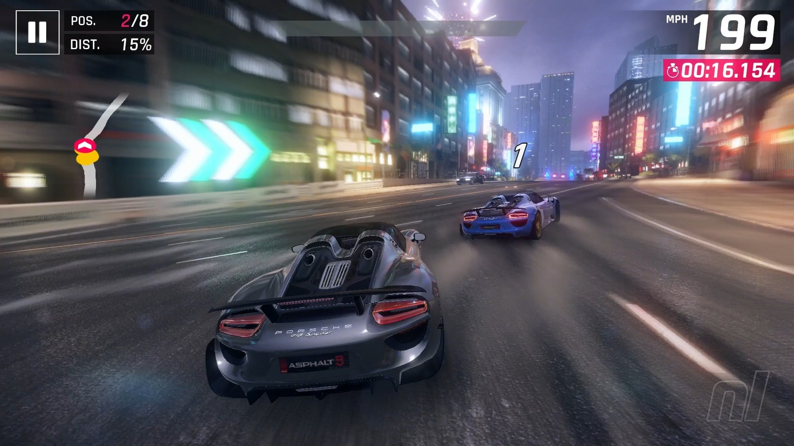
Overview
Genre: Arcade Racing.
Theme: Modern Cities/High-Speed Streets.
Play Value: Fast-paced, challenging, time attack.
Game Engine: Unity 3D
Graphic Style: Low Poly
Platform: Google Play Store
Target Audience: Fan of arcade racers (e.g. Asphalt), casual audience,
Design Pillars:
Speed and Flow
Simple Controls
Clear Challenge
Personal Best/Competition
Mobile-First

Slide 4
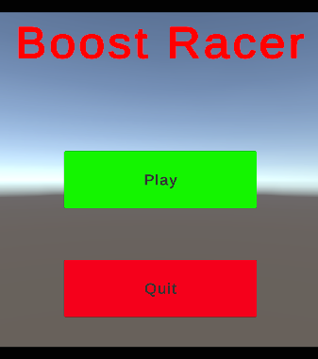
Gameplay
Core Mechanics:
Drive Car
Complete
Goal:
Finish Race
Race and beat other opponents (planned).
Obstacles:
Debris
Other cars/opponents (planned)
Traffic (Planned)
Weather phenomena (planned)

Slide 5
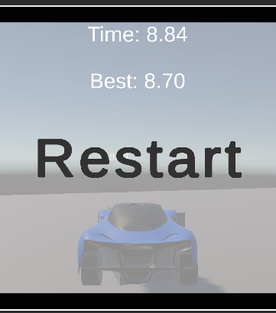
Advanced Mechanics
Give players the ability to switch perspectives (e.g. from above car, from drivers' position, from front of car, rear view) – Planned.
Using OpenWeatherAI for weather patterns and influencing weather related incidents in the race. - Planned
Drift mechanics to enhance the racing experience and allow skill expression for higher skilled players. – Planned.
Including achievements, leaderboard and social media plugins to enhance social and competitive element of the game. – Planned.

Slide 6
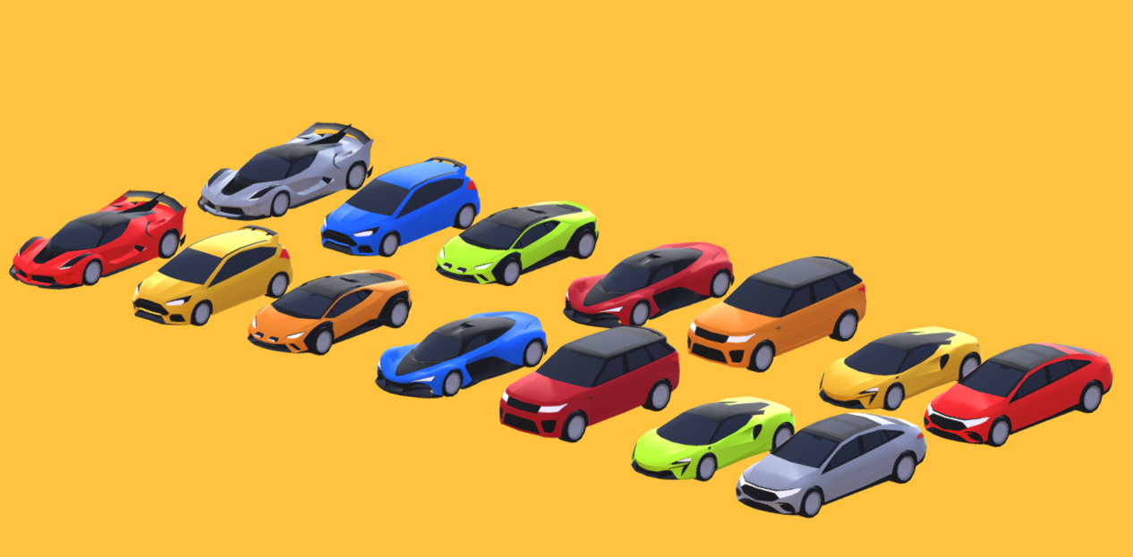
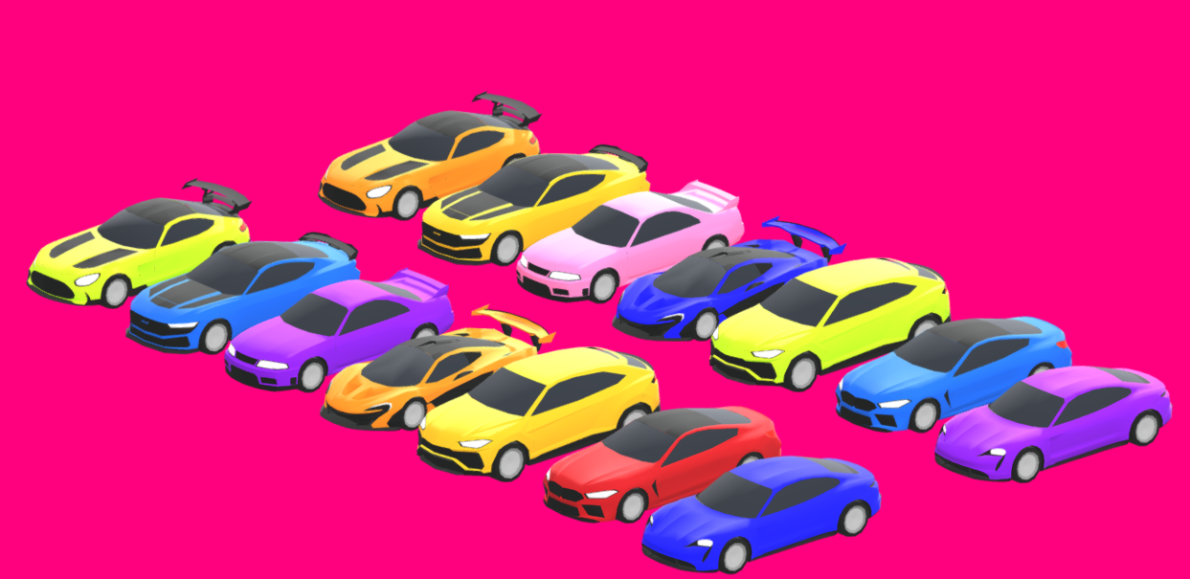
Gameplay
Progression:
Unlocking new cars.
Unlocking new skins/decals for cars
Increasing player level
Ranked mode

Slide 7
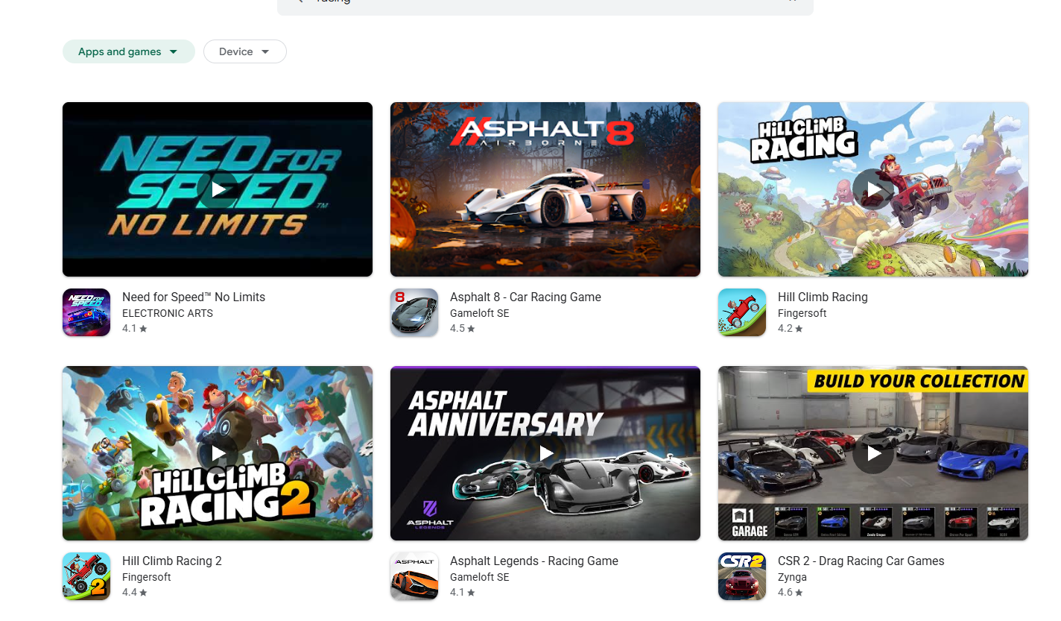
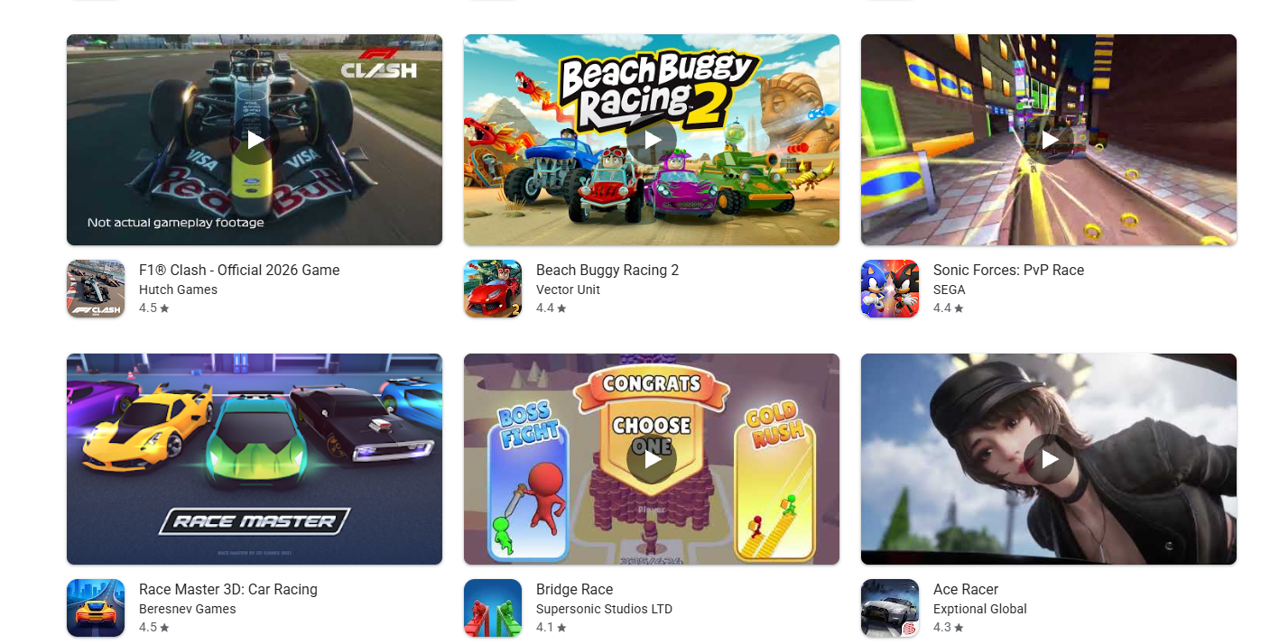
Market
After looking through potential competitors on the market, I have two key points:
There are lots of arcade racers.
Most are using the “hyper realistic style”.
My product will attempt to fill the market gap of stylised/low poly arcade racers.

Slide 8
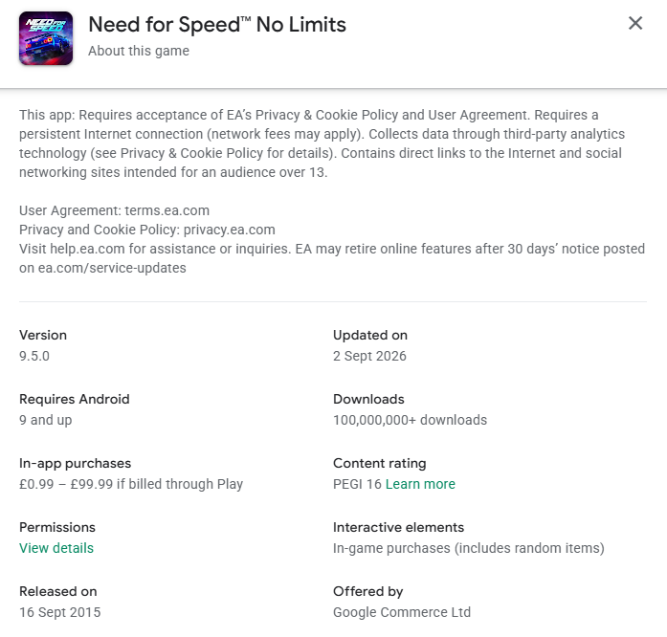
Need for Speed No Limits – Electronic Arts
Need for Speed as an arcade racer mobile rendition. Similar gameplay to Real Racing 3.
Free to Play with in app purchases.
100,000,000+ downloads.

Slide 9
My Analytic Model
Using Unity Analytics
Using google Play to track player base

Slide 10
Monetization
Free to Play
Integrating ads using Unity Ads.
In-app purchases for in-game currency, cars and cosmetics.

